Slide 1
Autopilot for the R44
New Product Introduction
AEA Convention, Las Vegas
March 26-29, 2018

Slide 2
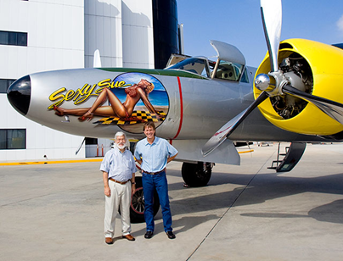


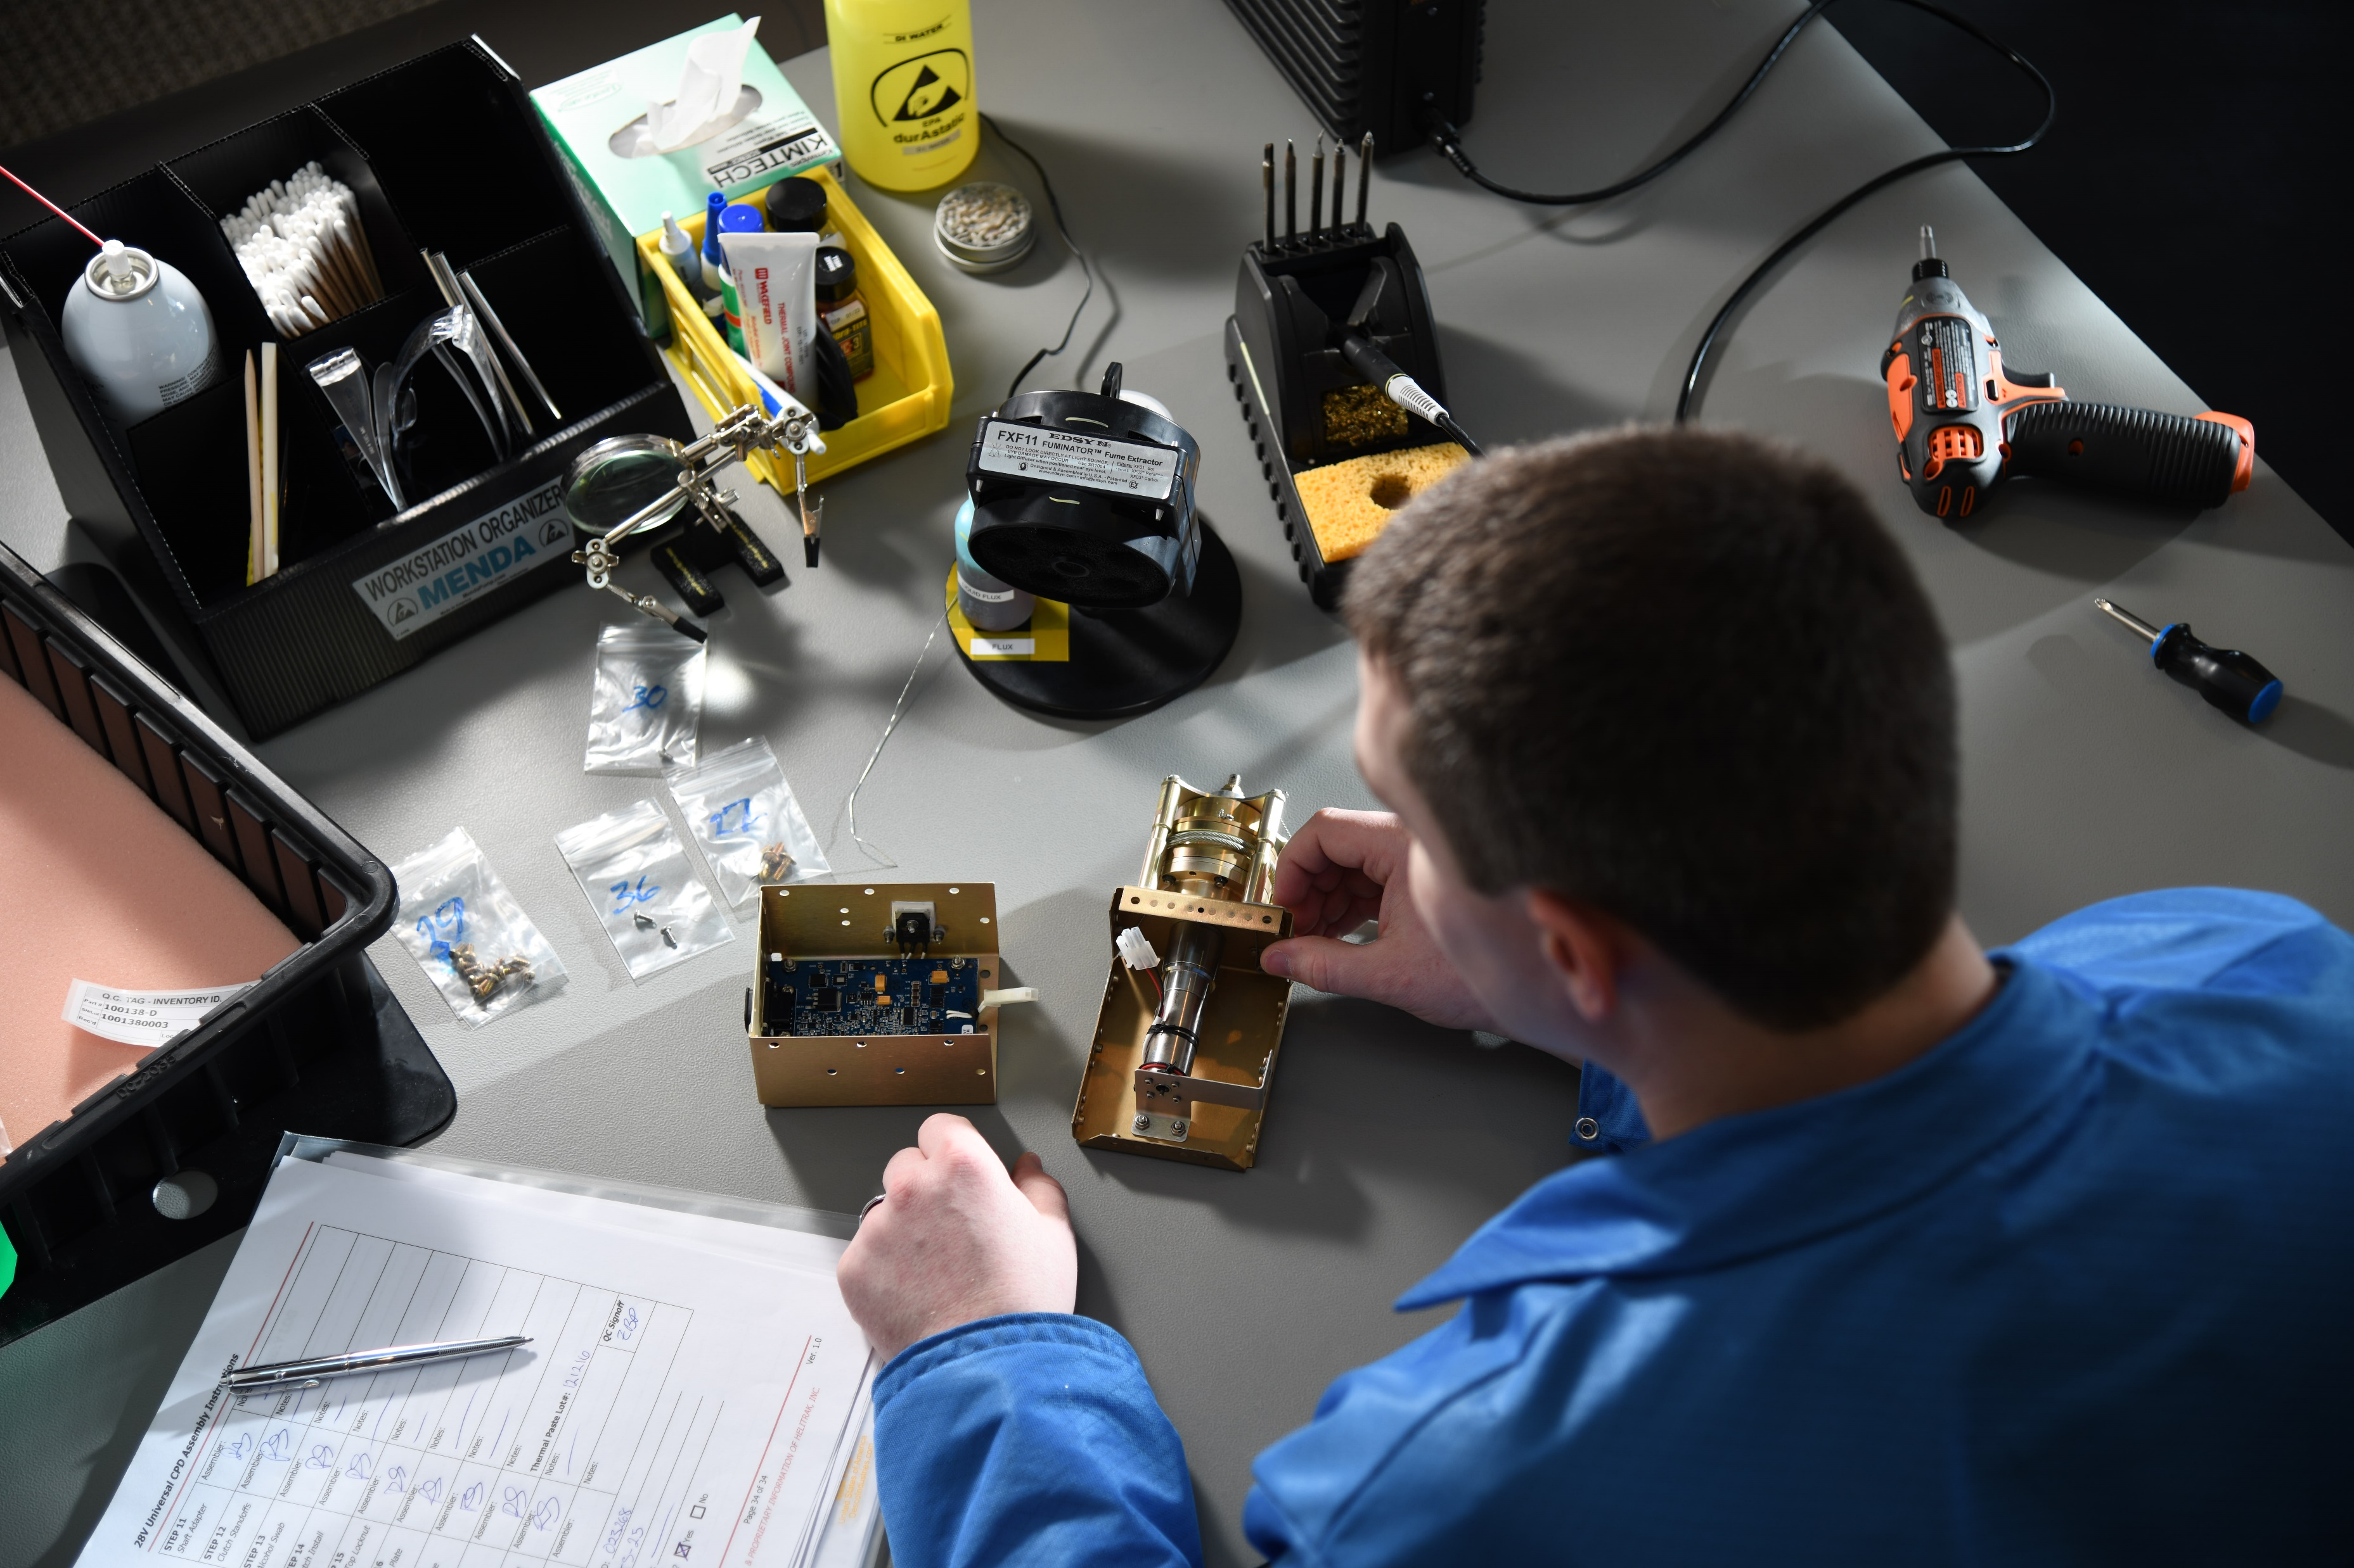
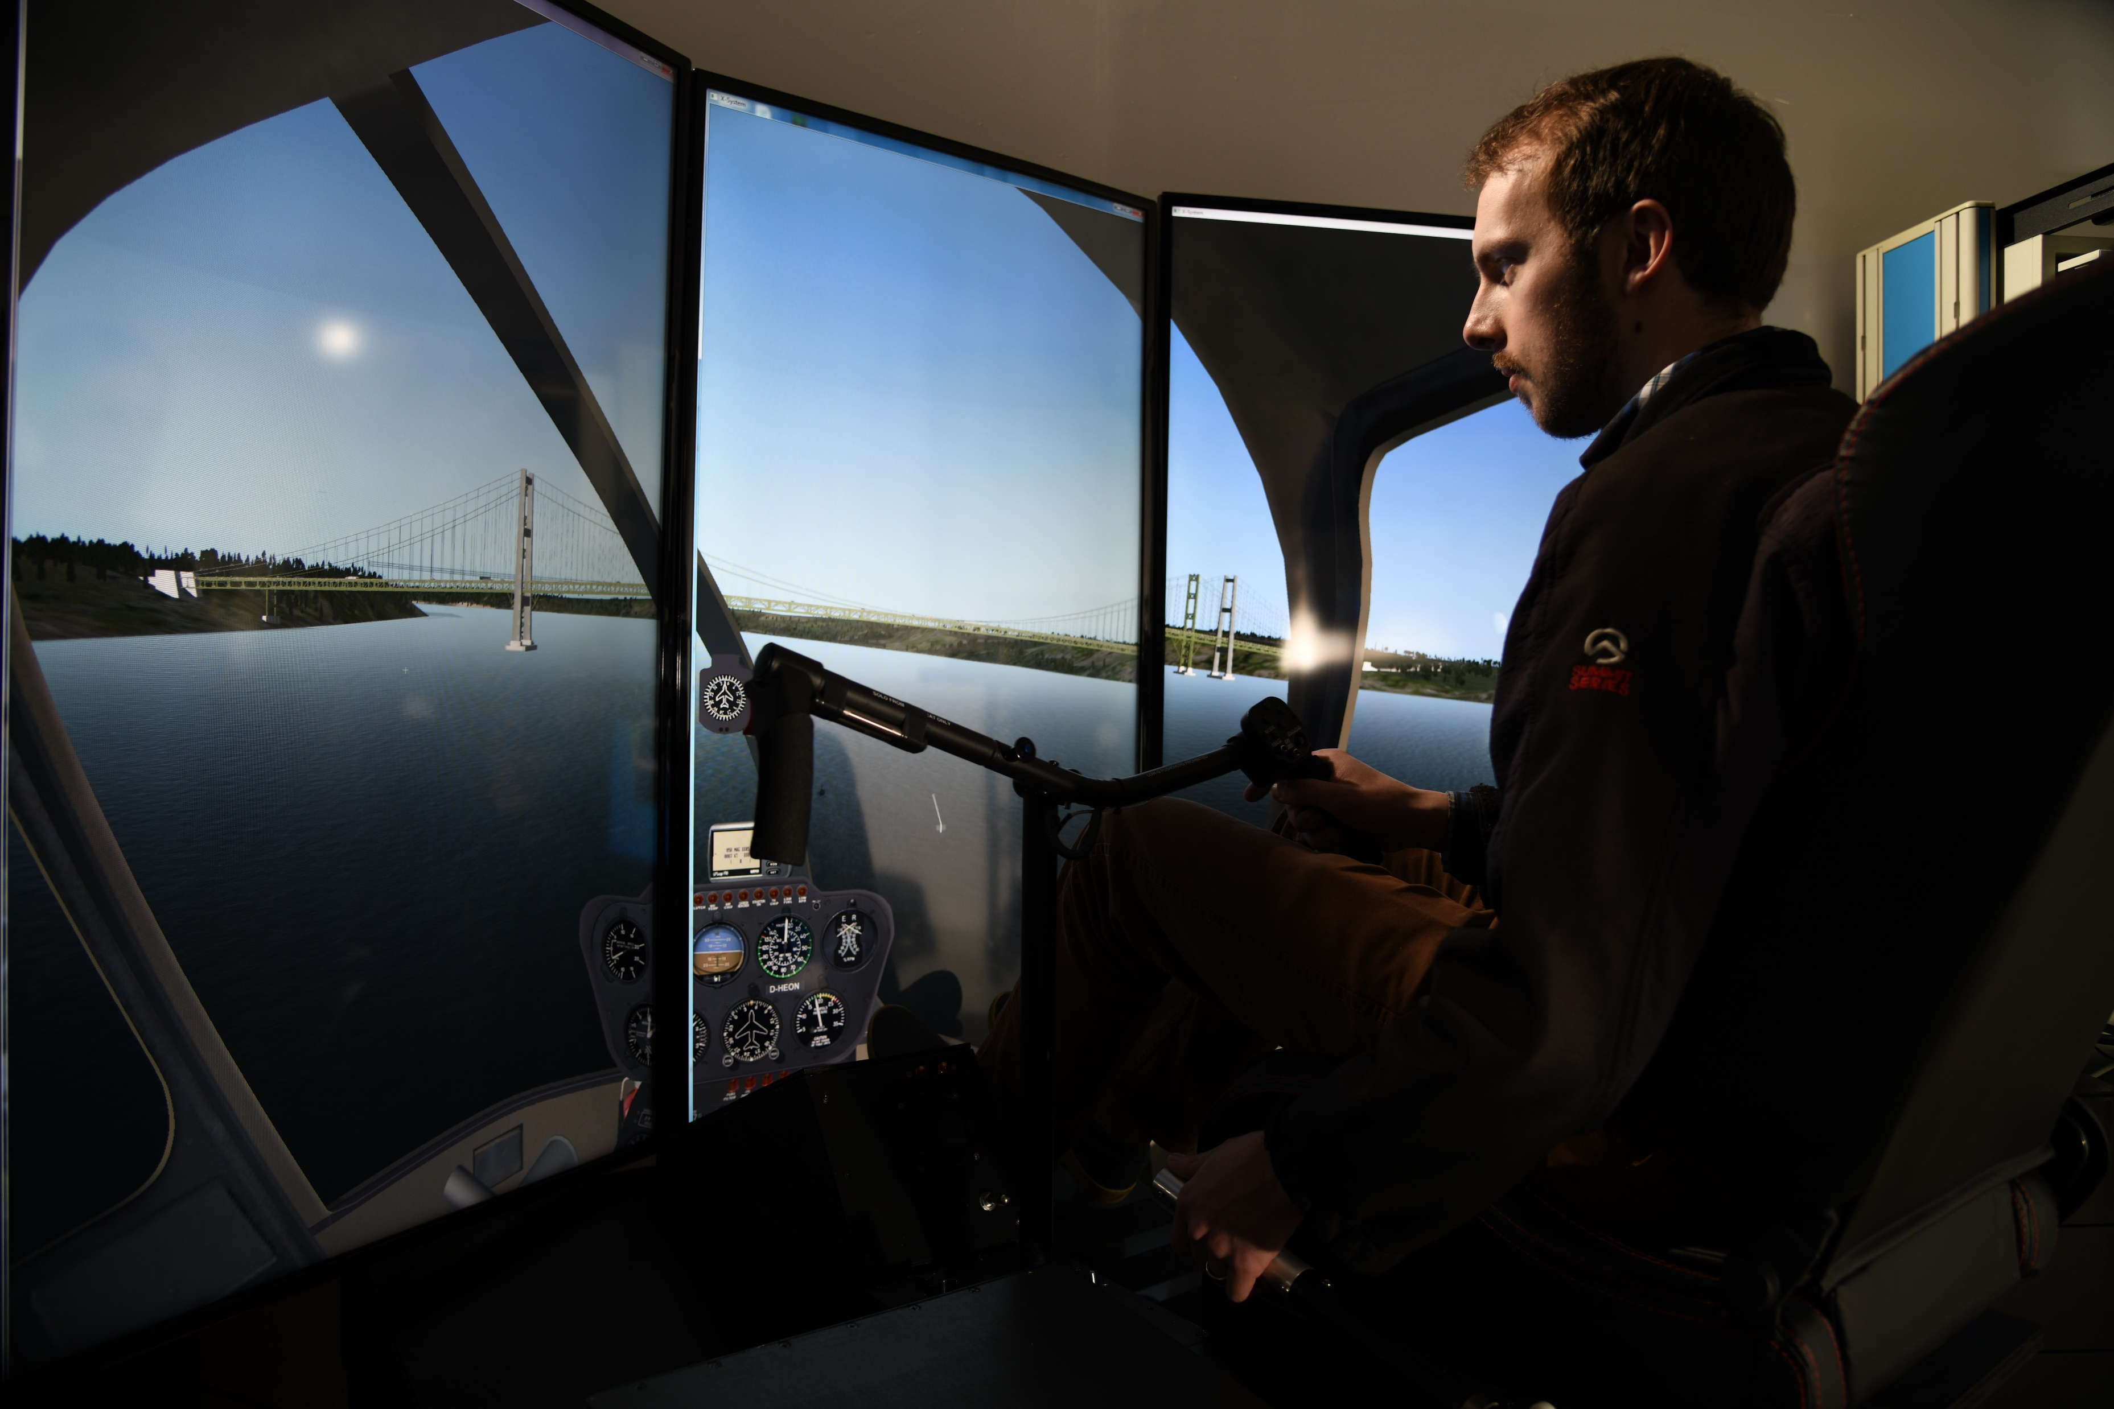
About Us – Who We Are
Organically funded subsidiary of Digital Control, Incorporated
  World’s leader in guidance systems used for underground Horizontal Directional Drilling (HDD) marketplace
HeliTrak founded by co-owners John Mercer and Peter Hambling to foster their passion for aviation
15 Employees and growing
Strong Engineering, Technology & Operations Capability
Full FAA Product Certification, Approved Quality System & Manufacturing Facility
HeliTrak focuses on the design and manufacture of innovative, disruptive, and affordable products that improve safety and efficiency, while providing unprecedented levels of support to our customers.

Slide 3
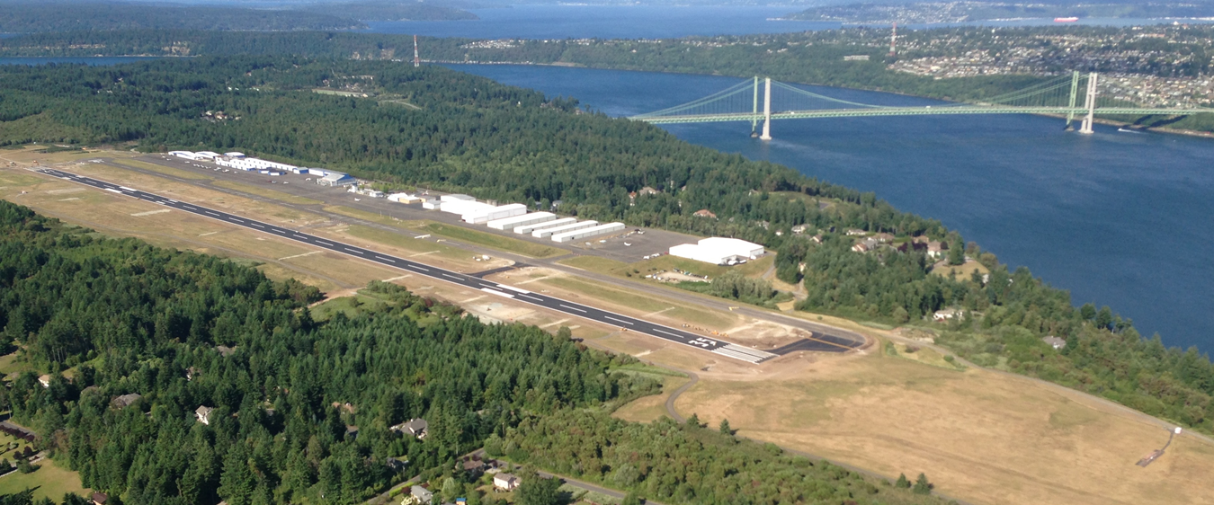
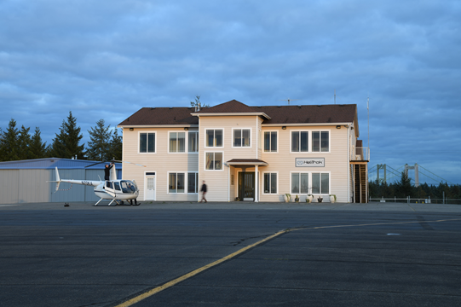
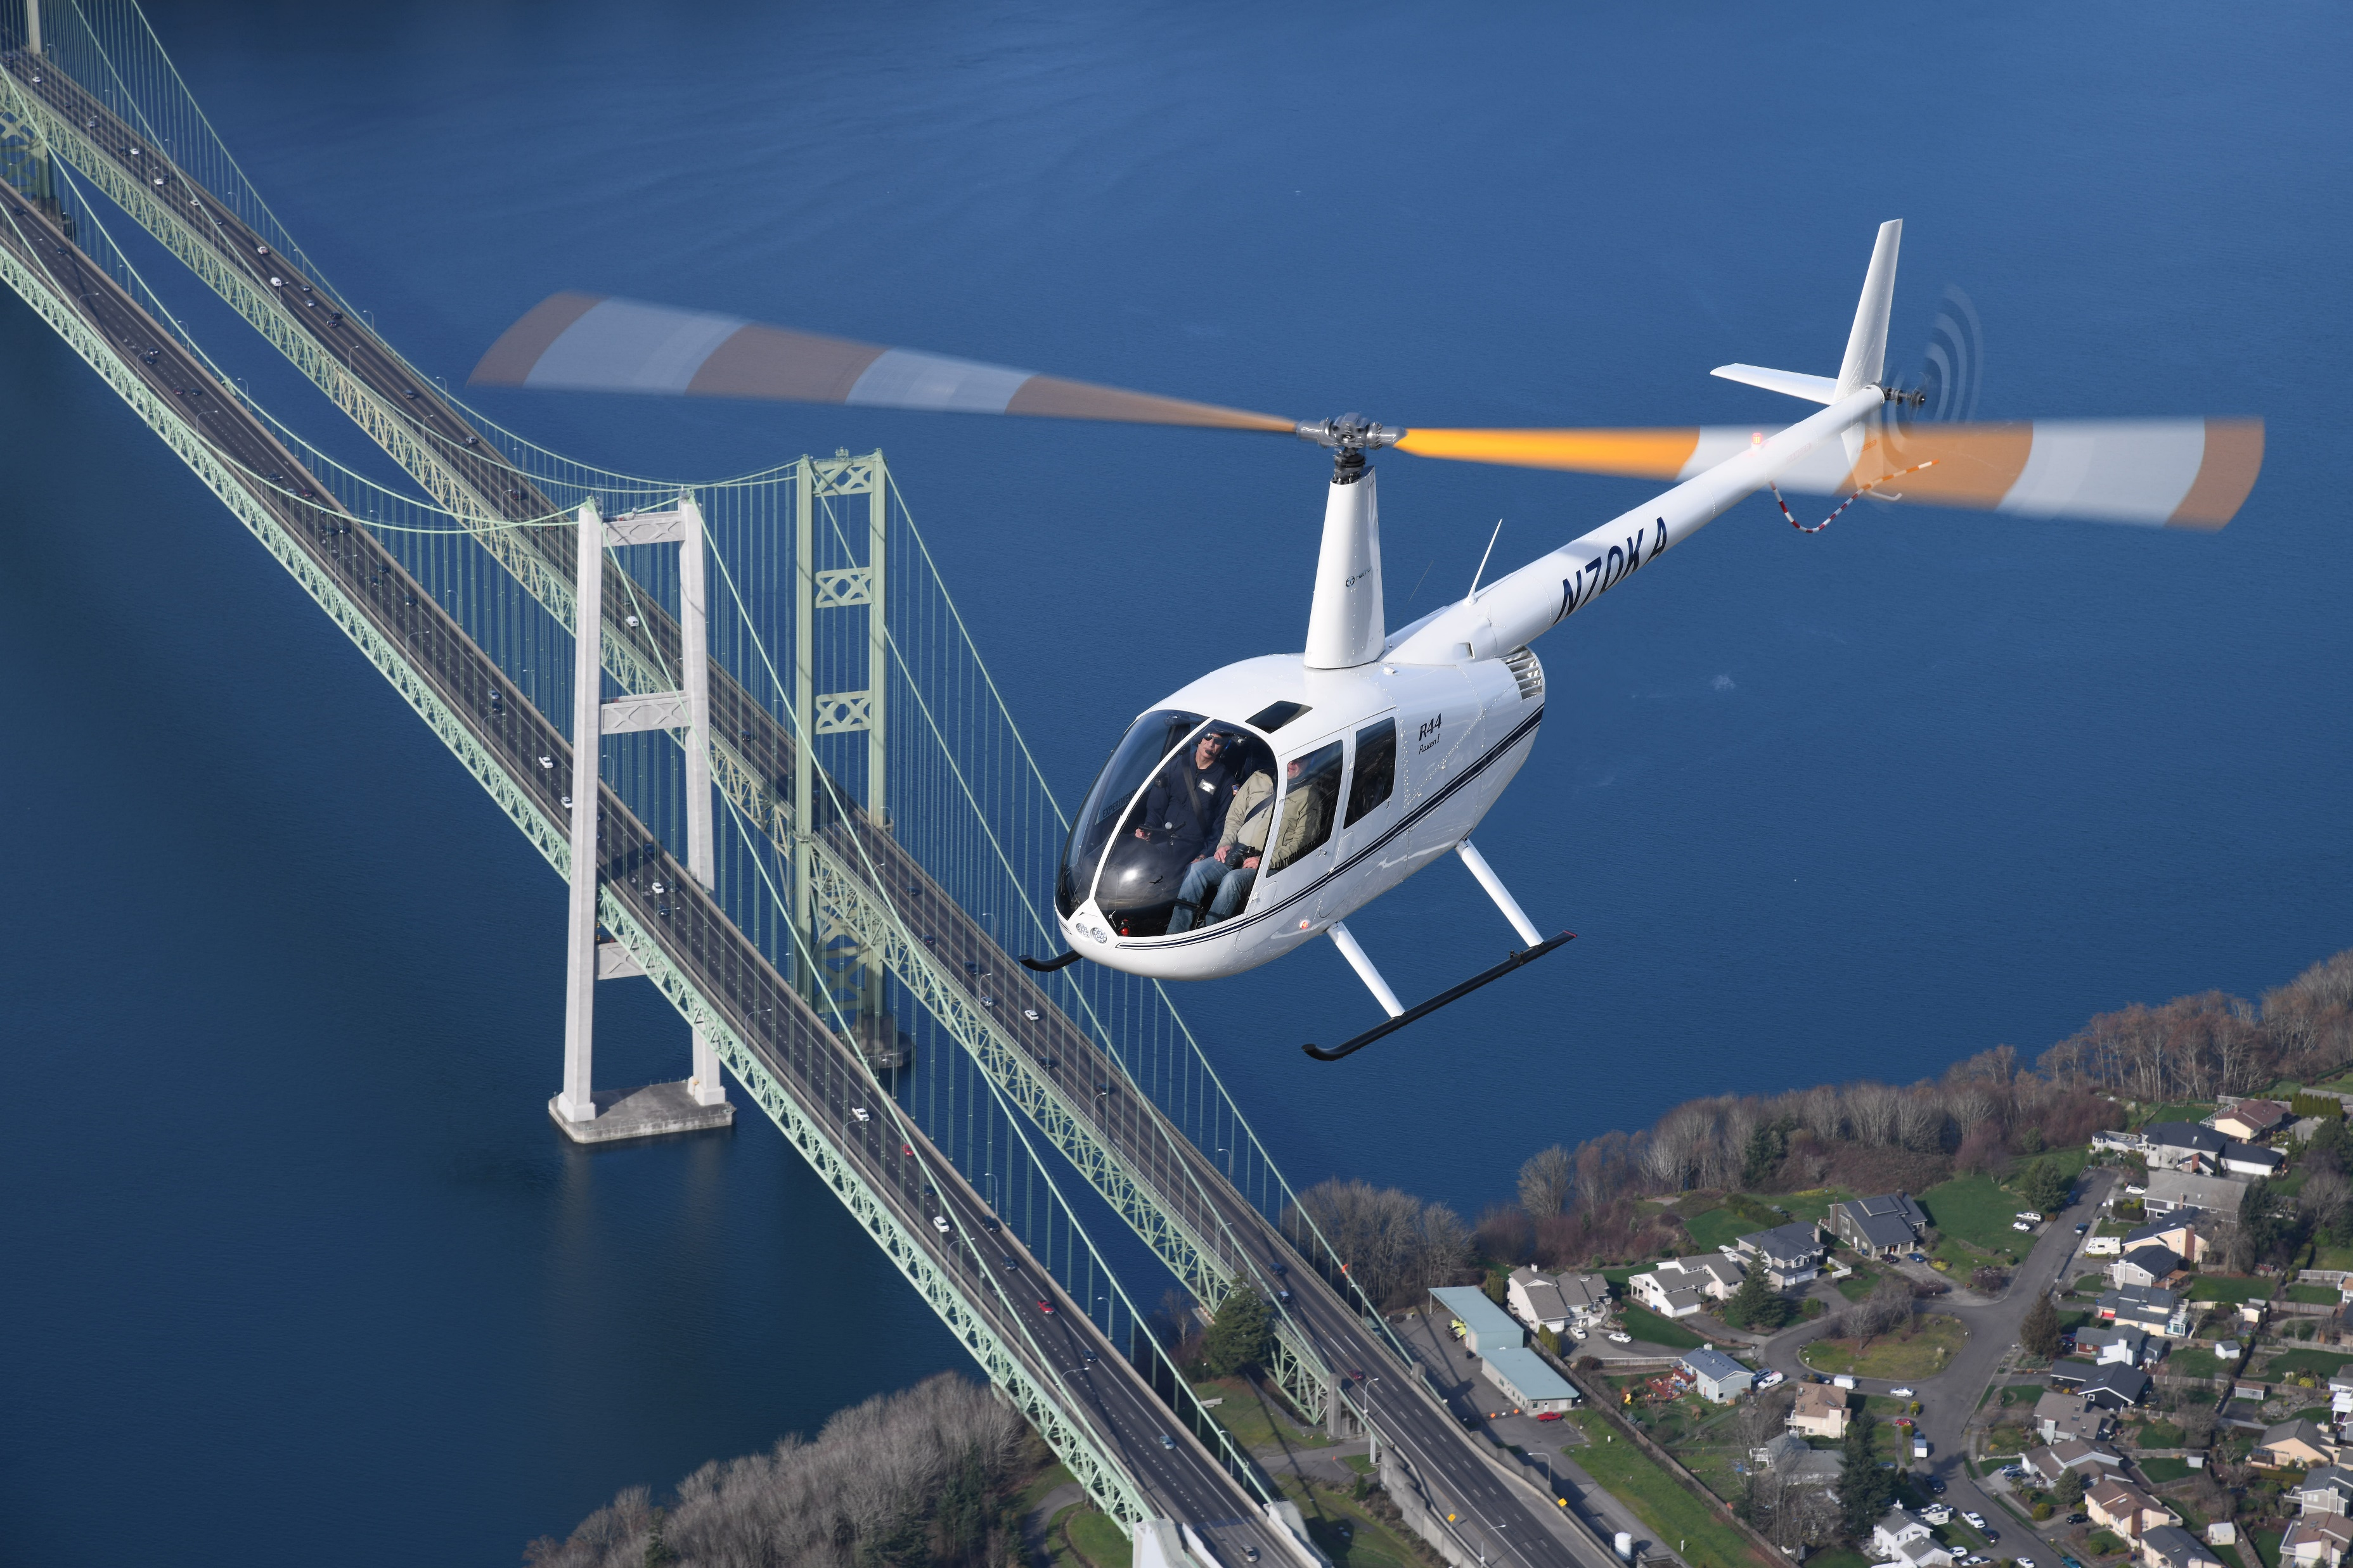
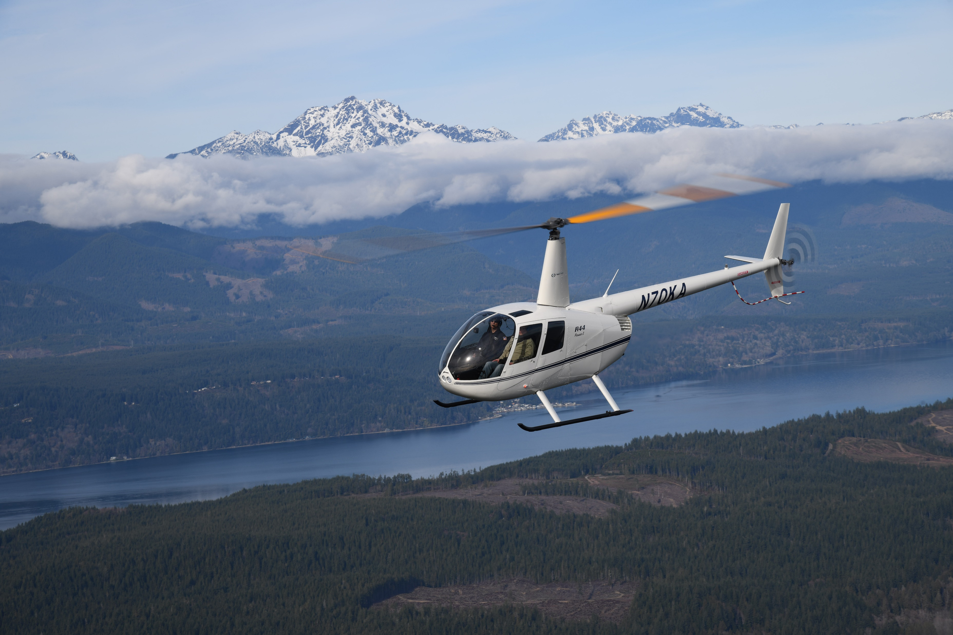
About Us – Location/Facilities
Located in Gig Harbor, WA on Pierce County’s Tacoma Narrows Airport (TIW)
Convenient South Puget Sound location within 30 min of SEATAC
HeliTrak, Inc.
Tacoma Narrows Airport (TIW)
1620 26th Avenue NW
Gig Harbor, WA 98335
47.27306, -122.57359

Slide 4
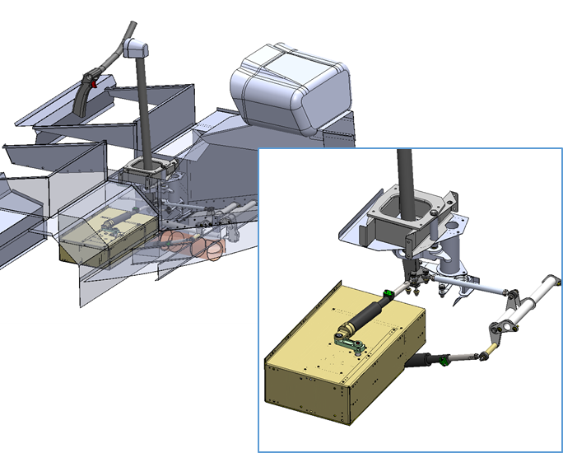
Robinson R44 Autopilot
Simple, but very High-Integrity Architecture and Design
  Level A Design Assurance Level Throughout
  Triplex control channel architecture, Dual motor actuation, Fail-Functional
  Meets basic pilot control tasks without adding complexity
Three system components:
  Autopilot Main Processor and Actuators
  Hand-On-Cyclic Mode Selector
  Panel or Stack Mount Indication and Alert Panel
Fully self-contained system, i.e. no external systems or integration required to install
Light-Weight, Small Footprint, Low Cost
  Less than 10 lbs (Target weight is just over 8 lbs complete)
  14” L x 13” W x 3” H – Fits conveniently under forward portion of R44 pilot seat box
  MSRP target at US $35-55k
Certification Target – 1Q19

Slide 5
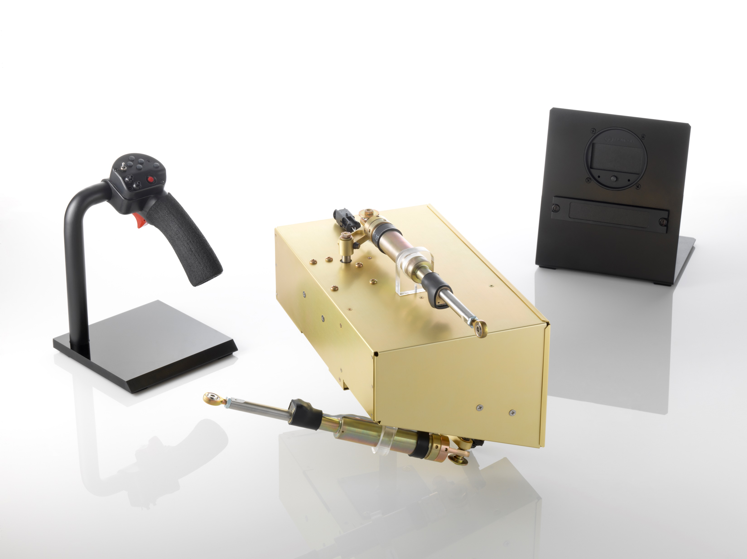
Two Axis Autopilot – 3 System Components
Autopilot Main Processing and Actuation
Hand-On-Cyclic Mode Controls
Panel Type Indication & Alerts
or
Stack Type Indication & Alerts

Slide 6
Two-Axis Autopilot – Functionality & Benefits
Cyclic Pitch/Roll Attitude Control, Attitude Hold Stabilization
Basic Control Modes
  Heading Hold
    Syncs to current heading on engage
    HDG Jog, 3 degrees per beep
    HDG Slew, Slew heading at turn rates up to ½ standard rate bank limit
  Altitude Hold
    Syncs to current altitude on engage
    ALT Jog, 50 ft per beep, Standard Rate Climb/Descend
  Speed Hold
    Syncs to current IAS on mode switch
    SPD Jog, 5 KIAS per beep, 0.1g limited Accel/Decel
Simple Mode Controls
Continuous Low-G detection and alerting
Unusual Attitude Recovery
Hand-On-Cyclic mode selection and push-button steering
Integrated with HeliTrak CPD to provide “Collective Down, Cyclic Aft” functionality
Pilot fly-through, or override, capability
Stand-Alone solution. No external parts or integration required.
Simple installation
Upgradable

Slide 7

Autopilot Growth
3-Axis (Yaw)
4-Axis (Yaw/PLA)
4+ Axis
GPS/NAV Integration
IFR Certification
R66, and other applications
Optionally Manned & Autonomous Flight

